Slide 1

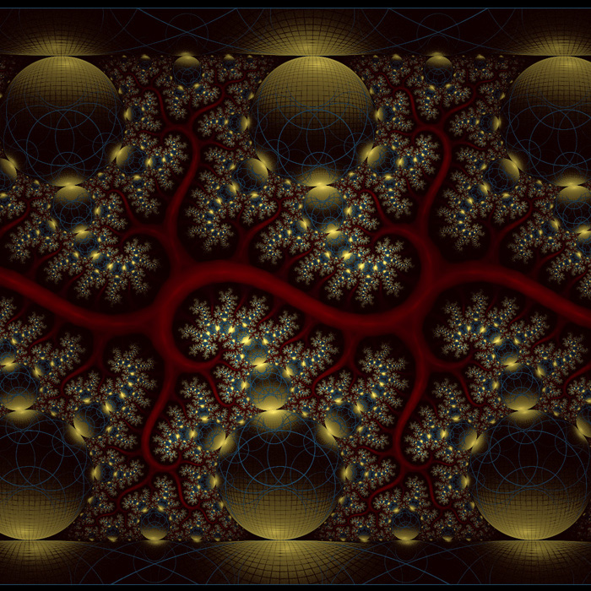
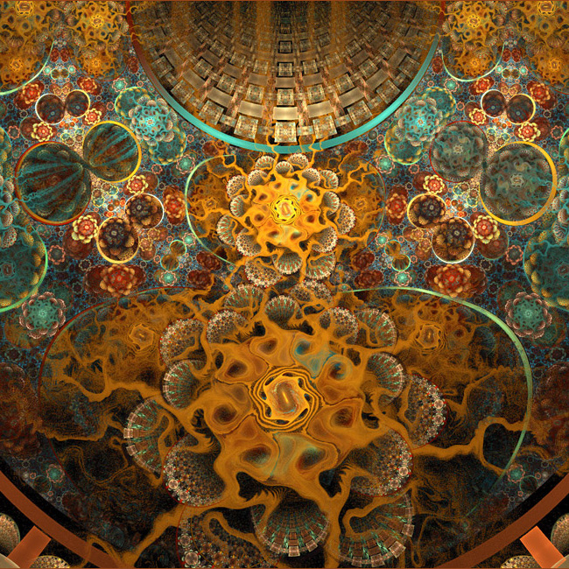
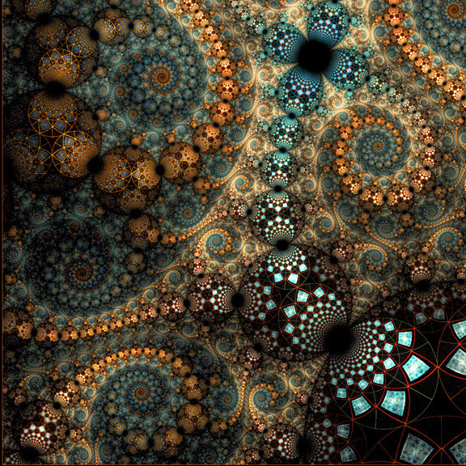


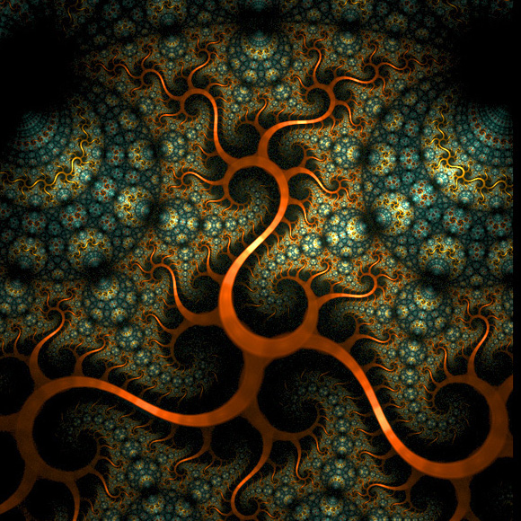
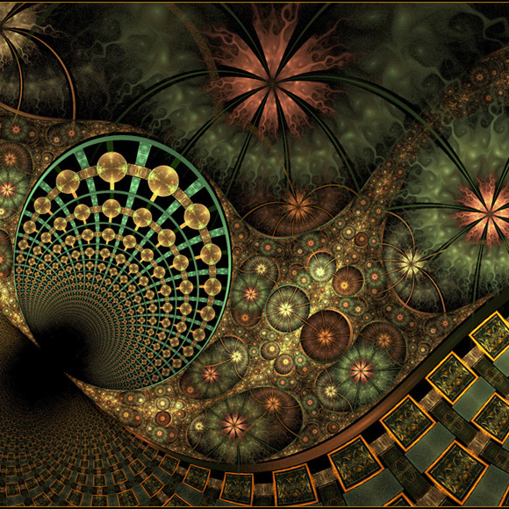
Category Learning: Fractal Set 1
Category Learning Task:
Exemplars: 1 – 4 Category 1 (Northern Hemisphere)
Exemplars: 5 – 8 Category 2 (Southern Hemisphere)

Slide 2
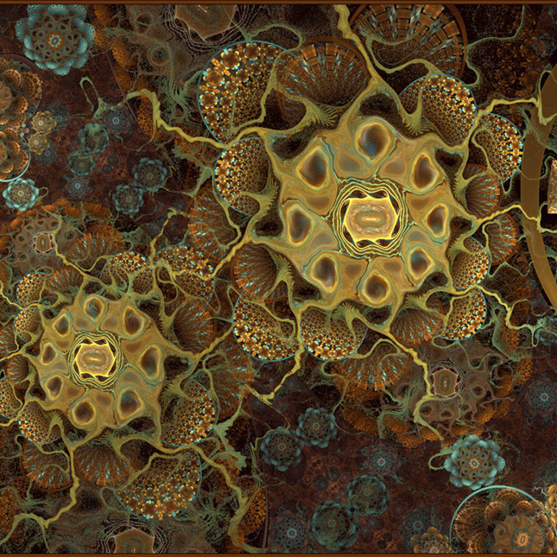







Category Learning: Fractal Set 2
Category Learning Task:
Exemplars: 1 – 4 Category 1 (Northern Hemisphere)
Exemplars: 5 – 8 Category 2 (Southern Hemisphere)

